Slide 2

Basics of HTML
HTML is the standard markup language for web pages and web applications.
With HTML you can create your own Website.
HTML stands for HYPERTEXT MARKUP LANGUAGE.
Extension of HTML file is .html
It tells a web browser how to display the text, images and other form of multimedia on a webpage.
HTML elements are represented by tags
Container Tag/ Pair Tag: The first tag in a pair is the start tag, the second tag is the end tag. The end tag is written like the start tag, with a forward slash before the tag name.
Start and end tags are also called opening tags and closing tags. For ex <b> and </b>
Empty Tag: Only opening tag is used. For ex <br> or <hr>

Slide 3
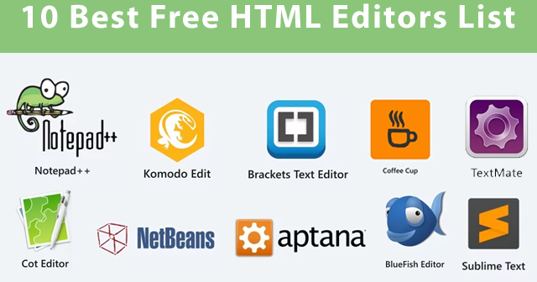
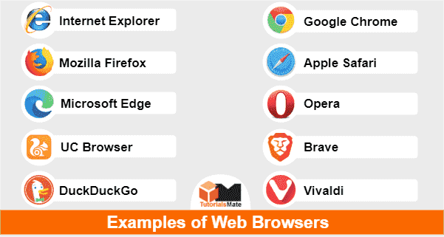
What do I need to create HTML?
Computer
Text or HTML editor: For ex, HTML editors are Dreamweaver, SeaMonkey, Coffee Cup, TextPad etc.
The text editors are include Notepad(for windows), Pico(for Linux), or Simpletext/ text Edit/TexT.
Web Browser. For Ex Internet Explorer of Firefox

Slide 4
HTML VERSIONS
HTML 1991
HTML 2.0 1995
HTML 3.2 1997
HTML 4.01 1999
XHTML 2000
HTML 5 2014

Slide 5
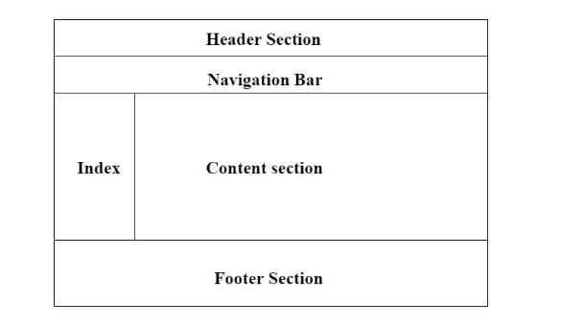
Web Page Layout Using HTML
Page layout is the part of graphic design that deals with the arrangement of visual elements on a page.
Page layout is used to make the web pages look better.
It establishes the overall appearance, relative importance, and relationships between the graphic elements to achieve a smooth flow of information and eye movement for maximum effectiveness or impact.

Slide 6
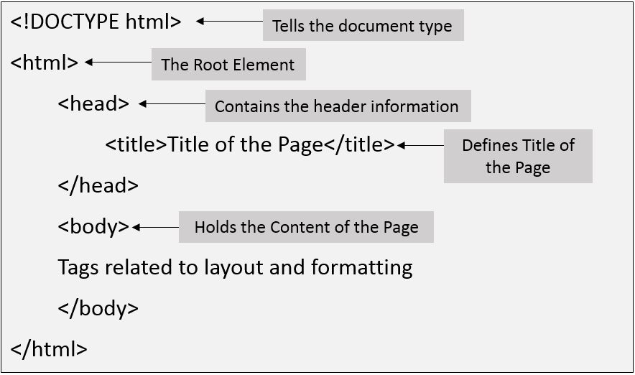
Structure of HTML page

Slide 7
Example Explained (Basic tags)
The <!DOCTYPE html> declaration defines that this document is an HTML5 document
The <html> element is the root element of an HTML page
The <head> element contains meta information about the HTML page
The <title> element specifies a title for the HTML page (which is shown in the browser's title bar or in the page's tab)
The <body> element defines the document's body, and is a container for all the, such as headings, paragraphs, images, hyperlinks, tables, lists, etc. visible contents
The <h1> element defines a large heading
The <p> element defines a paragraph

Slide 8
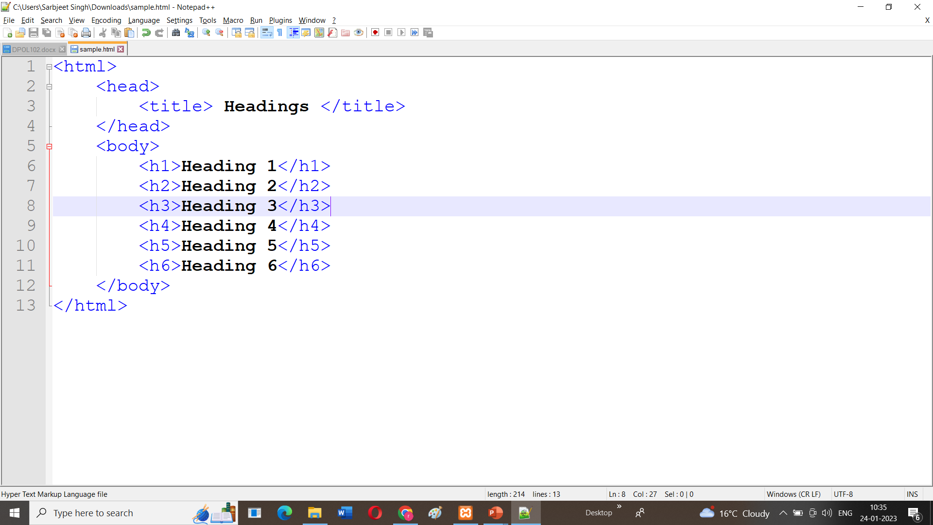
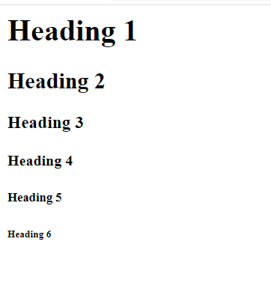
Heading Tags
We are having 6 heading tags
From h1 to h6
<H1> having the highest heading and <H6> having the smallest.

Slide 9
HTML Paragraphs
<p> is used to start the paragraph and </p> tag is used to close the paragraph.
It always starts on a new line and add some space as margin before and after the paragraph.

Slide 10
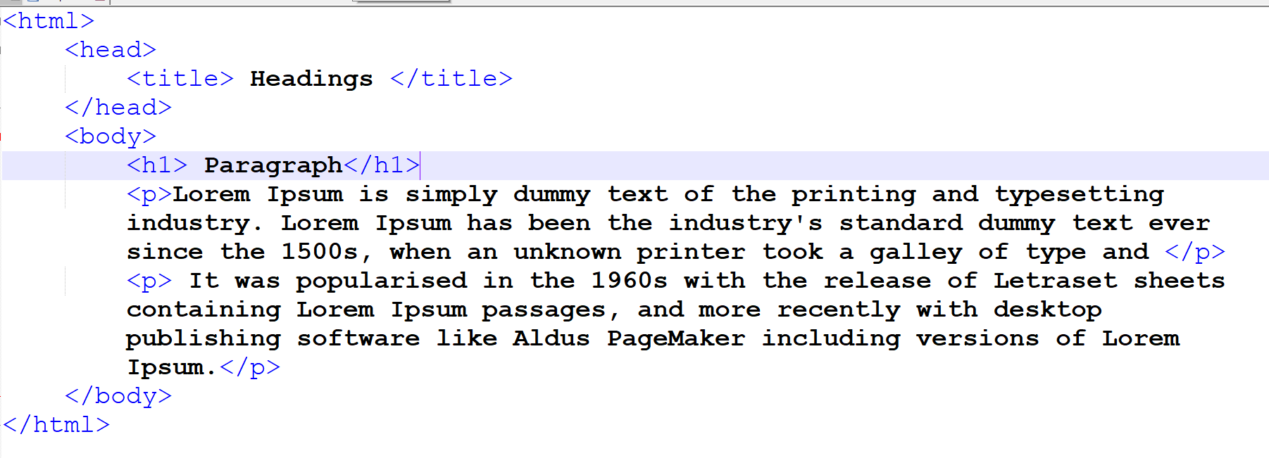
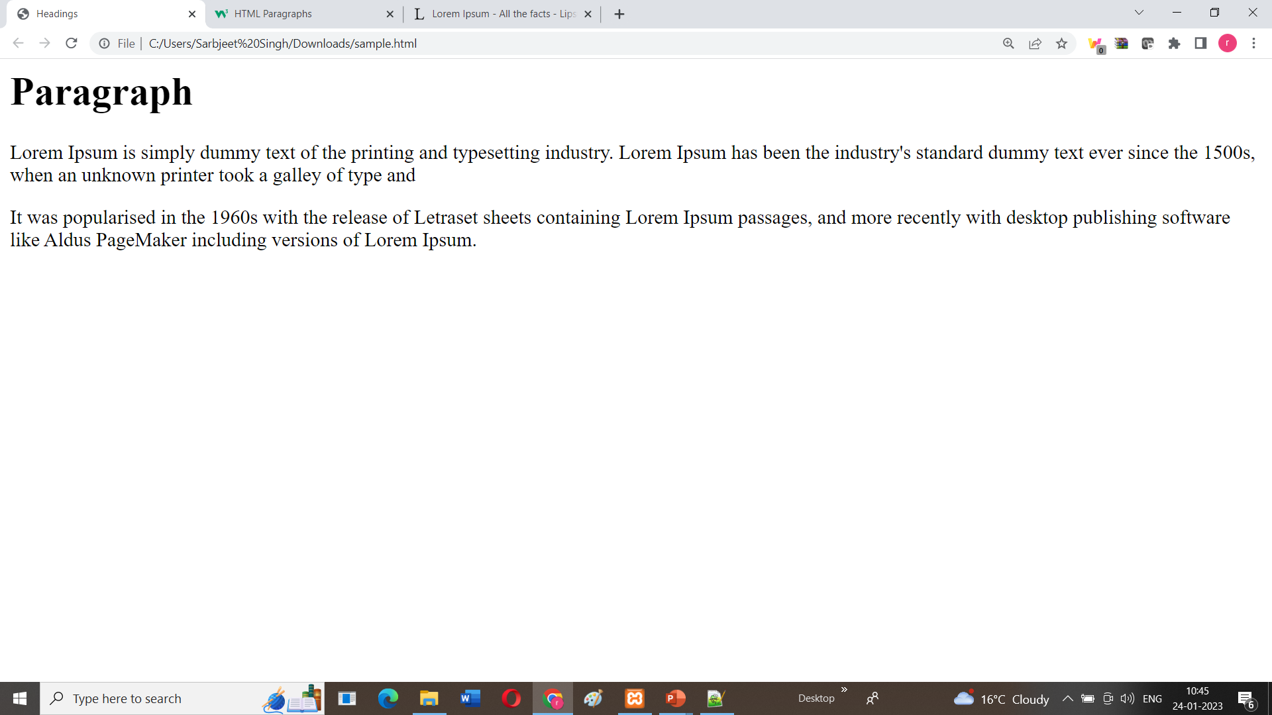

Slide 11
Formatting tags
<acronym> Not supported in HTML5. Use <abbr> instead. Defines an acronym
<abbr> Defines an abbreviation or an acronym
<address> Defines contact information for the author/owner of a document/article
<b> Defines bold text
<bdi> Isolates a part of text that might be formatted in a different direction from other text outside it
<bdo> Overrides the current text direction
<big> Not supported in HTML5. Use CSS instead. Defines big text
<blockquote> Defines a section that is quoted from another source
<cite> Defines the title of a work
<code> Defines a piece of computer code

Slide 12
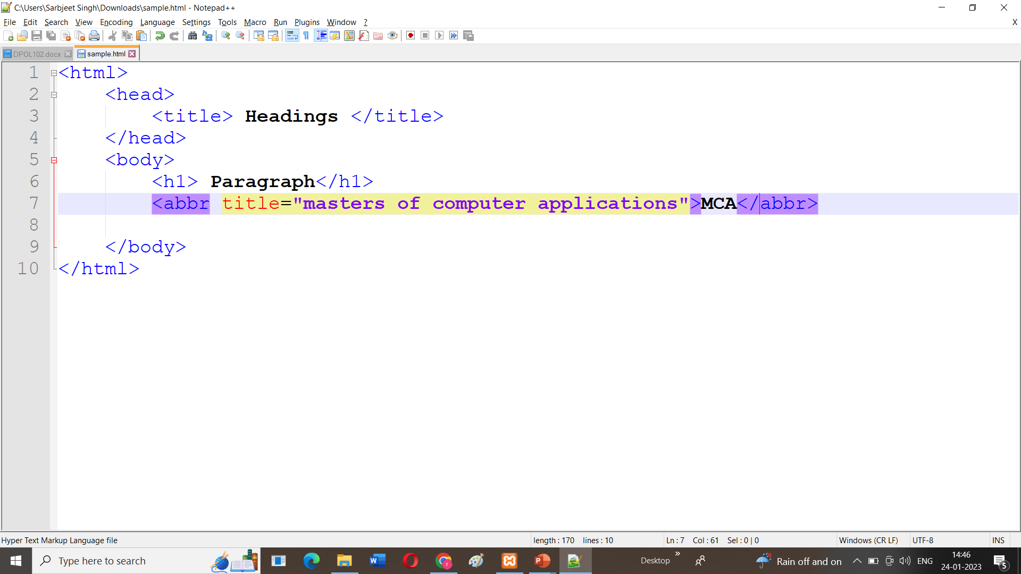
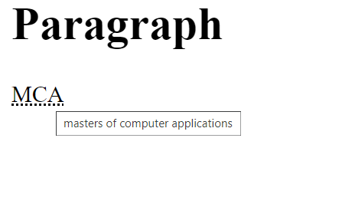
<Abbr> tag
Defines an abbreviation or an acronym
Title is used as its attribute

Slide 13
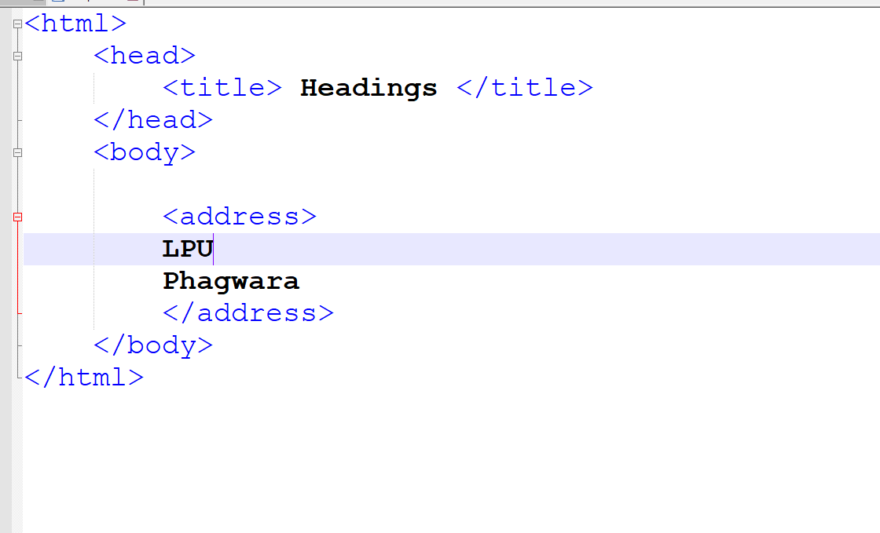
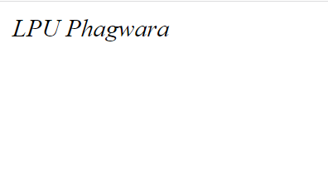
Address Tag
Address is used show the address on the screen

Slide 14
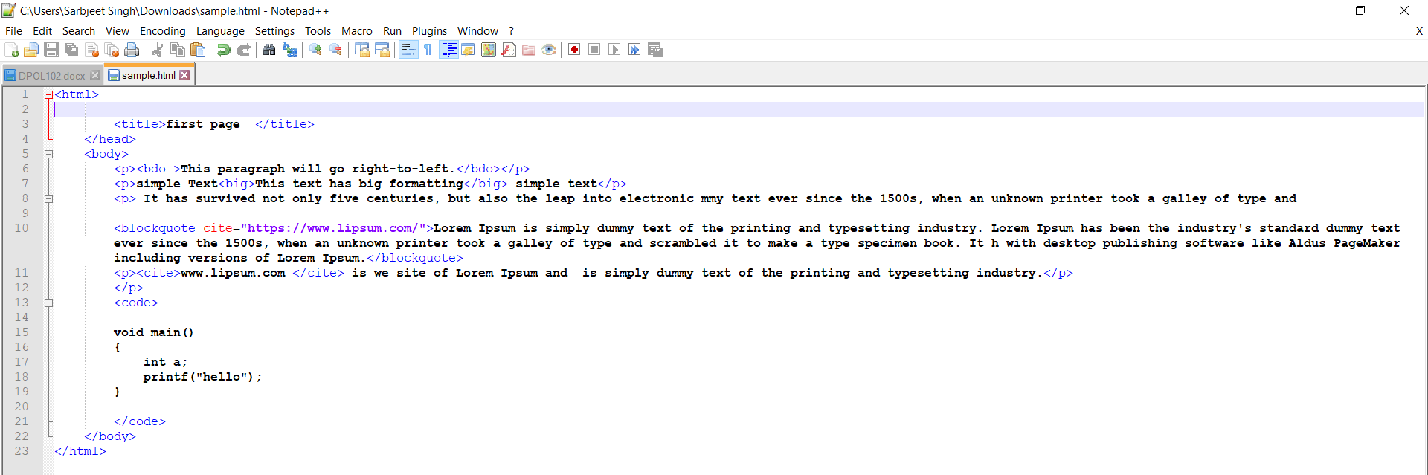
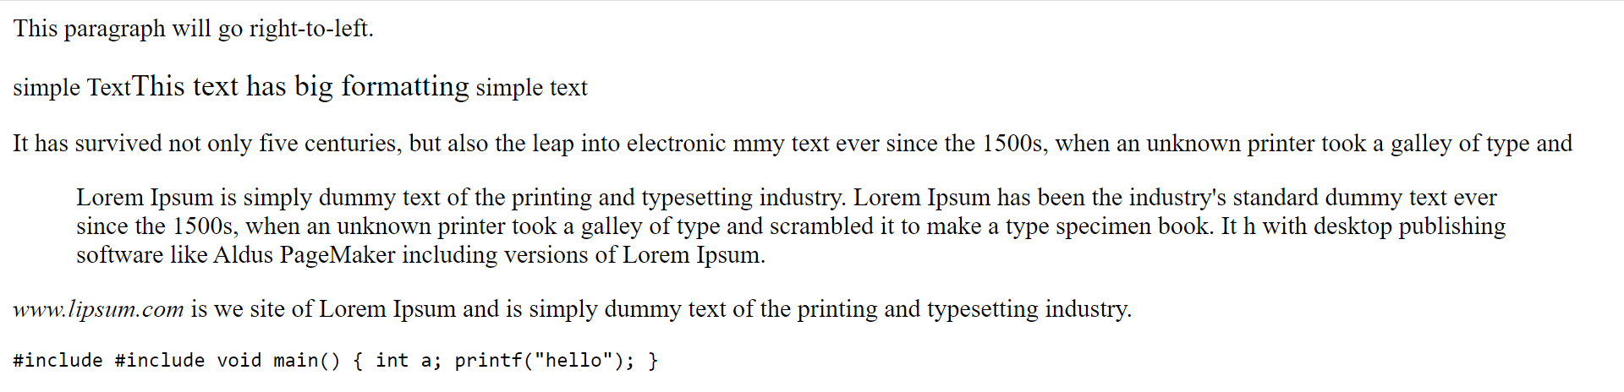

Slide 15
Some more Formatting Tags
<b> - Bold text
<strong> - Important text
<i> - Italic text
<em> - Emphasized text
<mark> - Marked text
<small> - Smaller text
<sub> - Subscript text
<sup> - Superscript text

Slide 16
HTML links- Hyperlinks
HTML links are hyperlinks.
You can click on a link and jump to another document.
When you move the mouse over a link, the mouse arrow will turn into a little hand.
** A link does not have to be text. A link can be an image or any other HTML element!**
Syntax: <a href="url">link text</a>
The most important attribute of the <a> element is the href attribute, which indicates the link's destination.
The link text is the part that will be visible to the reader.
Clicking on the link text, will send the reader to the specified URL address

Slide 17
HTML Links - The target Attribute
The target attribute specifies where to open the linked document.
The target attribute can have one of the following values:
_self - Default. Opens the document in the same window/tab as it was clicked
_blank - Opens the document in a new window or tab
_parent - Opens the document in the parent frame
_top - Opens the document in the full body of the window
Link to an Email Address : Use mailto: inside the href attribute to create a link that opens the user's email program (to let them send a new email):
Example: <a href="mailto:someone@example.com">Send email</a>

Slide 18
HTML image links
It's simple to use an image as hyperlink.
We just need to use an image inside hyperlink at the place of text as shown below −
Example : <body>
<p>Click following link</p>
<a href = "https://www.spoint.com" target = "_self">
<img src = "/images/logo.png" alt = “SPoint" border = "0"/>
</a>
</body>

Slide 19
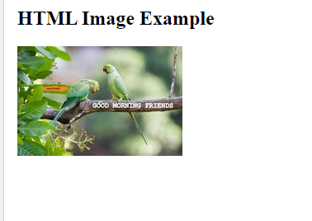
Web page Layout using HTML
Working with images in web pages (Background image, image map and image)
HTML img tag is used to display image on the web page. HTML img tag is an empty tag that contains attributes only, closing tags are not used in HTML image element.
<h2>HTML Image Example</h2>
<img src="good_morning.jpg" alt="Good Morning Friends"/>

Slide 20
Attributes of HTML img tag
The src and alt are important attributes of HTML img tag.
1) src
2) alt
3) width
4) height
5) border
Use of height and width attribute with img tag
<img src="animal.jpg" height="180" width="300" alt="animal image">

Slide 21
Common Image Formats
Abbreviation | File Format | File Extension
APNG | Animated Portable Network Graphics | .apng
GIF | Graphics Interchange Format | .gif
ICO | Microsoft Icon | .ico, .cur
JPEG | Joint Photographic Expert Group image | .jpg, .jpeg, .jfif, .pjpeg, .pjp
PNG | Portable Network Graphics | .png
SVG | Scalable Vector Graphics | .svg

Slide 22
Question
How to insert an image in HTML?
<img href = "jtp.png" />
<img url = "jtp.png" />
<img link = "jtp.png" />
<img src = "jtp.png" />

Slide 23
HTML Lists
HTML Lists are used to specify lists of information. All lists may contain one or more list elements. There are three different types of HTML lists:
Ordered List or Numbered List (ol)
Unordered List or Bulleted List (ul)
Description List or Definition List (dl)
**We can create a list inside another list, which will be termed as nested List.**

Slide 24
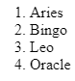
HTML Ordered List or Numbered List
In the ordered HTML lists, all the list items are marked with numbers by default. It is known as numbered list also. The ordered list starts with <ol> tag and the list items start with <li> tag.
Example Program: <html>
<body>
<ol>
<li>Aries</li>
<li>Bingo</li>
<li>Leo</li>
<li>Oracle</li>
</ol>
</body>
</html>

Slide 25
Type attribute
we can use type attribute for <ol> tag to specify the type of numbering.
By default, it is a number
<ol type = "1"> - Default-Case Numerals.
<ol type = "I"> - Upper-Case Numerals.
<ol type = "i"> - Lower-Case Numerals.
<ol type = "A"> - Upper-Case Letters.
<ol type = "a"> - Lower-Case Letters.

Slide 26
Example program
<body>
<ol type = "1"> <ol type= "I" > , <ul type = "circle">, <ul type = "square">, <ul type = "disc">
<li>Beetroot</li>
<li>Ginger</li>
<li>Potato</li>
<li>Radish</li>
</ol>
</body>

Slide 27
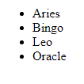
HTML Unordered List or Bulleted List
In HTML Unordered list, all the list items are marked with bullets. It is also known as bulleted list also. The Unordered list starts with <ul> tag and list items start with the <li> tag.
<ul type="disc">
<li>Aries</li>
<li>Bingo</li>
<li>Leo</li>
<li>Oracle</li>
</ul>
Type can be
Circle
disc
Square
none

Slide 28
HTML Description List or Definition List
HTML Description list is also a list style which is supported by HTML and XHTML. It is also known as definition list where entries are listed like a dictionary or encyclopedia.
The definition list is very appropriate when you want to present glossary, list of terms or other name-value list.
The HTML definition list contains following three tags:
<dl> tag defines the start of the list.
<dt> tag defines a term.
<dd> tag defines the term definition (description).
</dl> − Defines the end of the list

Slide 29
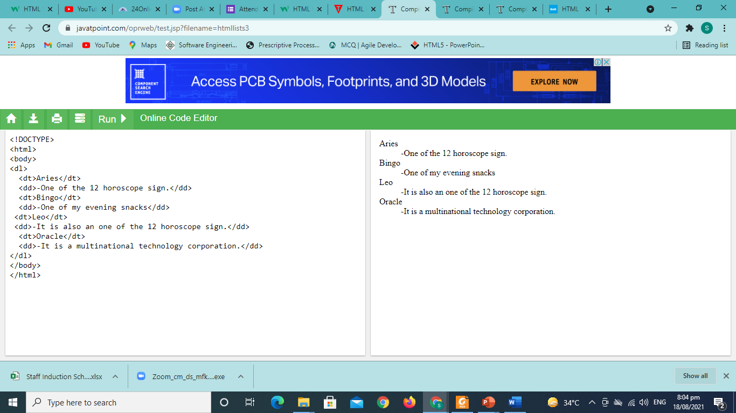
Example Program
<dl>
<dt>Aries</dt>
<dd>-One of the 12 horoscope sign.</dd>
<dt>Bingo</dt>
<dd>-One of my evening snacks</dd>
<dt>Leo</dt>
<dd>-It is also an one of the 12 horoscope sign.</dd>
<dt>Oracle</dt>
<dd>-It is a multinational technology corporation.</dd>
</dl>

Slide 30
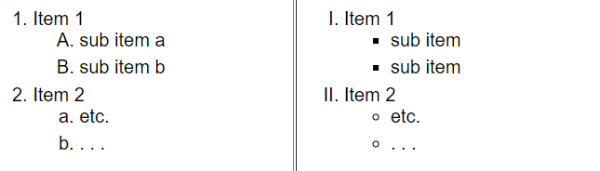
Assignment

Slide 32
Tables in a webpages

Slide 33
Introduction to Tables
What is a Table?
A table is a grid organized into columns and rows, much like a spreadsheet.
1 | 2 | 3 | 4 | 5
6 | 7 | 8 | 9 | 10
11 | 12 | 13 | 14 | 15
16 | 17 | 18 | 19 | 20

Slide 34
Why do we use tables?
Tables were initially developed as a method to organize and display data in columns and rows
Creating a Data Table
Activity 1: Creating a Table
 | Monday | Tuesday | Wednesday | Thursday | Friday
6- 7 pm | Look at website | Free | Implementation | Free | Free
7 – 8 pm | Take some notes | Free | Implementation | Free | Free

Slide 35
Cont…
<style> table, th, td { border: 1px solid black; } </style> ….. <TABLE style= “width: 80%” >

Slide 36
Cont…
The <TR> tag
Orange cell | Blue cell | Green cell

Slide 37
<TABLE style= "width: 80%" align = "center"> <tr align = "center">
Orange cell | Blue cell | Green cell

Slide 38
Cont…
<TD width=25% height=70 bgcolor="red"> <p style="font-family: verdana">red cell </p> </td> <TD width=75% bgcolor="lightblue"> <p style="font-family: Comic Sans MS"> light blue cell </p></td>
Orange cell | Blue cell | Green cell

Slide 39
Example Program
<style> table, th, td { border: 1px solid black; } </style> </HEAD> <BODY> <TABLE style= "width: 80%" align = "center"> <caption> CSC503 timetable </caption> <tr > <td width=50%> </td> <th width = 150> Monday </th> <th width = 150> Tuesday</th> <th width = 150> Wednesday </th> <th width = 150> Thursday</th> <th width = 150> Friday</th> </tr> <tr > <td > 6-7pm </td> <td > Look at website</td> <td > free </td> <td > Implementation </td> <td > free </td> <td > free </td> </tr> <tr > <td > 7-8pm </td> <td > Take some notes</td> <td > free </td> <td > Implementation </td> <td > free </td> <td > free </td> </tr> </TABLE> </BODY > </HTML >

Slide 40
Using Tables in Page Design
Tables are useful for laying out text and images on in Web page Advantages: • Default Setting: therefore no new tags are needed — the Web page fills entire space. • Philosophical: flexibility is the philosophy of the Web i.e. it should be accessible by the greatest number of users. • Realistic: resolutions, monitor and window sizes are always different. Keeping a Web page flexible allows it to be viewed on many available formats. Disadvantages: • Uncomfortable: reading text on large monitors is uncomfortable as the lines are too long. • Unpredictability: the designer often cannot predict how a Web page will appear under varying resolutions and live space sizes. • Coherence: on small monitors, everything may not appear correctly.

Slide 41
Using rowspan
<TABLE style= "width: 30%" align = "center">
<tr >
<td bgcolor = "red" rowspan = 2 width = 75> red cell</td>
<td bgcolor = “Blue" height =100> Blue cell</td>
</tr>
<tr >
<td bgcolor = “Orange" height =100> Orange cell</td>
</tr>
</TABLE>
Dark red cell | Blue cell
 | Orange cell

Slide 42
Using colspan, cellspacing and cellpadding

Slide 43
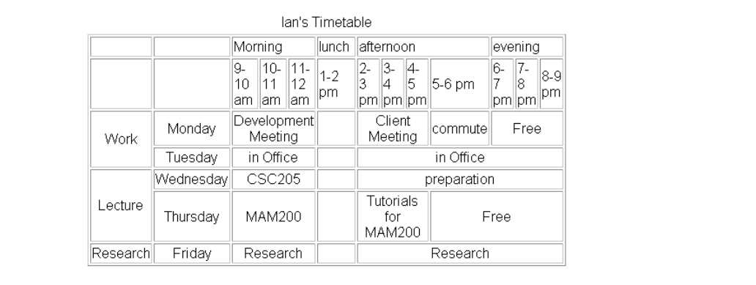
What will be the program code?

Slide 44
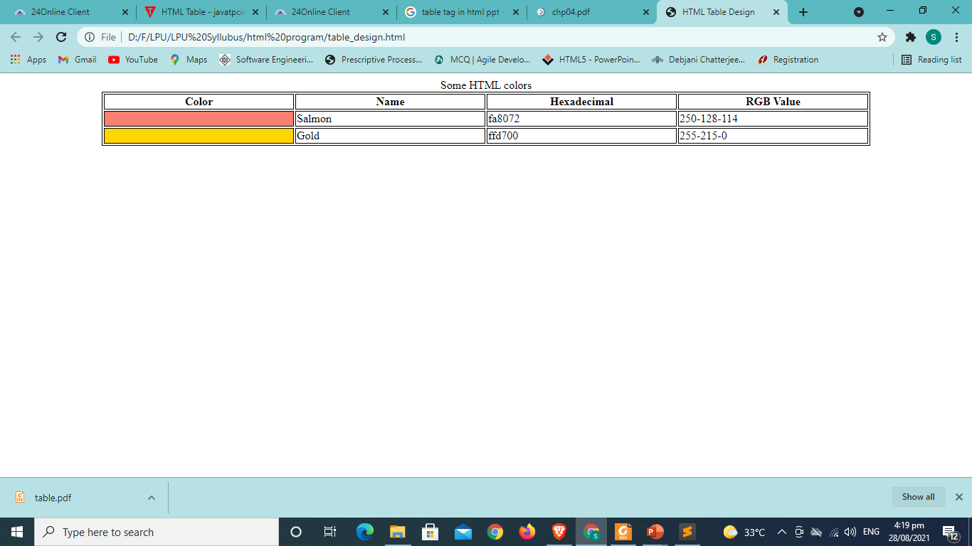
What will be the program code?

Slide 46
Forms in HTML

Slide 47
An HTML form is used to collect user input. The user input is most often sent to a server for processing.
<form> tag is used to create forms in HTML.
<form> is a paired tag.
HTML forms are used to create (rather primitive) GUIs on Webpage.
Usually the purpose is to ask the user for information
The information is then sent back to the server
A form is an area that can contain form elements
The syntax is: <form parameters> ...form elements... </form>
Form elements include: buttons, checkboxes, text fields, radio buttons, drop-down menus, etc
Other kinds of HTML tags can be mixed in with the form elements
A form usually contains a Submit button to send the information in the form elements to the server

Slide 48
<input> tag type="..." argument to tell which kind of element it is
Type | Description
<input type="text"> | Displays a single-line text input field
<input type="radio"> | Displays a radio button (for selecting one of many choices)
<input type="checkbox"> | Displays a checkbox (for selecting zero or more of many choices)
<input type="submit"> | Displays a submit button (for submitting the form)
<input type="button"> | Displays a clickable button

Slide 49
Values of type attribute
<input type="button">
<input type="checkbox">
<input type="color">
<input type="date">
<input type="datetime-local">
<input type="email">
<input type="file">
<input type="hidden">
<input type="image">
<input type="month">
<input type="number">
<input type="password">
<input type="radio">
<input type="range">
<input type="reset">
<input type="search">
<input type="submit">
<input type="tel">
<input type="text">
<input type="time">
<input type="url">
<input type="week">

Slide 50
<label> tag
The <label> tag defines a label for many form elements.
<label for="firstname">First name</label>
The for attribute of the <label> tag should be equal to the id attribute of the <input> element to bind them together.

Slide 51
Text Fields
The <input type="text"> defines a single-line input field for text input.
<input type="text" id="fname" maxlength=5 name="fname" placeholder="first name">

Slide 52
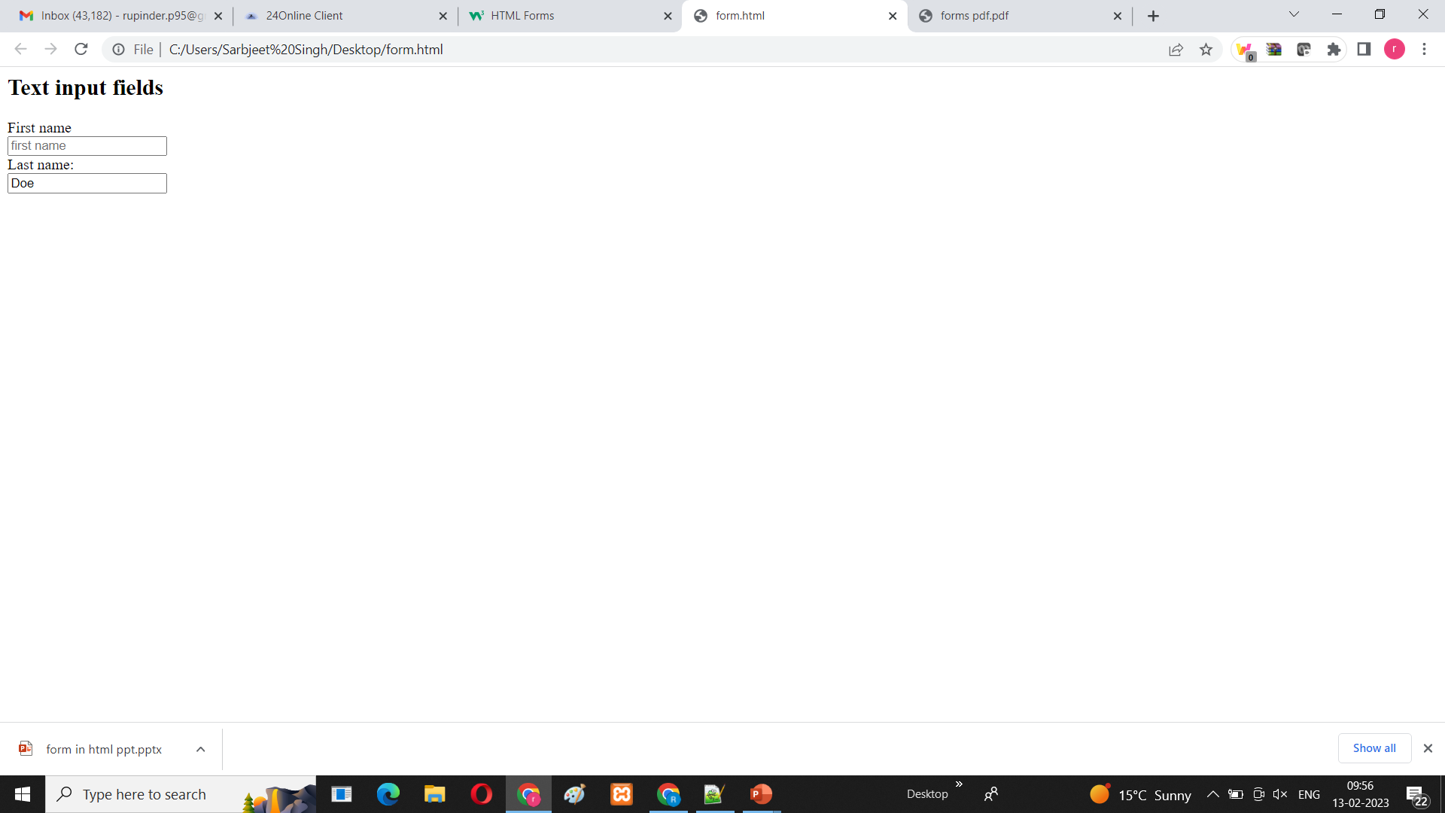
Example
<form>
<label for="firstname">First name</label> <br>
<input type="text" id="fname" name="fname" placeholder="first name"><br>
<label for="lname">Last name:</label><br>
<input type="text" id="lname" name="lname" value="Doe">
</form>

Slide 53
Password
To encrypt the written content we use type=“password”
<input type="password" maxlength=5 id="password" name="password" >
It will show the entire written content in dotted form.

Slide 54
Radio Buttons
The <input type="radio"> defines a radio button.
Radio buttons let a user select ONE of a limited number of choices.

Slide 55
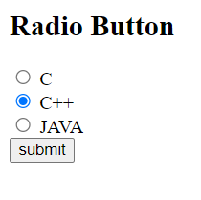
Example
<html>
<body>
<h2>Radio Button</h2>
<form>
<input type="radio" id="html" name="language" value="c">
<label for="html">C</label><br>
<input type="radio" id="css" name="language" value="C++“ checked>
<label for="css">C++</label><br>
<input type="radio" id="c++" name="language" value="Java">
<label for="javascript">JAVA</label>
<br>
<input type="submit" value="submit">
</form>
</body>
</html>

Slide 56
Checkboxes
The <input type="checkbox"> defines a checkbox.
Checkboxes let a user select ZERO or MORE options of a limited number of choices.
Checked attribute used if you already want some options to be selected by default.

Slide 57
Submit Button
The <input type="submit"> defines a button for submitting the form data to a form-handler.
The form-handler is typically a file on the server with a script for processing input data.
<input type="submit" value="Submit">

Slide 58

Example
<html>
<body>
<h2>checkbox</h2>
<form>
<input type="checkbox" id="html" name="language" value="c">
<label for="html">C</label><br>
<input type="checkbox" id="css" name="language" value="C++" checked >
<label for="css">C++</label><br>
<input type="checkbox" id="c++" name="language" value="Java">
<label for="javascript">JAVA</label>
</form>
</body>
</html>

Slide 59
Textarea
To Write data in multiple lines we use <textarea> tag of form.
<textarea rows=20 cols=10 id="area"> Enter your Address here….</textarea>

Slide 60
<select>
<select> tag is use to define a drop down list.
<option> Element is used to define data of drop down list.
The <option> elements defines an option that can be selected.
By default, the first item in the drop-down list is selected.
To define a pre-selected option, add the selected attribute to the option.

Slide 61
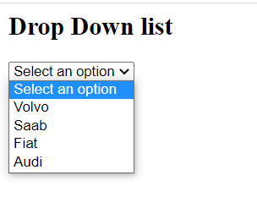
Example
<html>
<body>
<h2>Drop Down list</h2>
<form>
<select id="cars" name="cars" size="1">
<option value="select">Select an option....</option>
<option value="volvo">Volvo</option>
<option value="saab">Saab</option>
<option value="fiat">Fiat</option>
<option value="audi">Audi</option>
</select>
</form>
</body>
</html>

Slide 62
Fieldset
The <fieldset> element is used to group related data in a form.
The <legend> element defines a caption for the <fieldset> element.

Slide 63

Example
<html>
<body>
<h2>Drop Down list</h2>
<form>
<fieldset>
<legend>DATA</legend>
<select id="cars" name="cars" size="1">
<option value="select">Select an option....</option>
<option value="volvo">Volvo</option>
<option value="saab">Saab</option>
<option value="fiat">Fiat</option>
<option value="audi">Audi</option>
</select>
</fieldset>
</form>
</body>
</html>

Slide 64
Block-level Elements
A block-level element always starts on a new line, and the browsers automatically add some space (a margin) before and after the element.
A block-level element always takes up the full width available (stretches out to the left and right as far as it can
<blockquote>
<dd>
<dl>
<dt>
<fieldset>
<h1>-<h6>
<hr>
<li>
<ol>
<p>

Slide 65
Inline Elements
An inline element does not start on a new line.
An inline element only takes up as much width as necessary.
<a>
<abbr>
<acronym>
<b>
<big>
<br>
<button>

